Slide 1
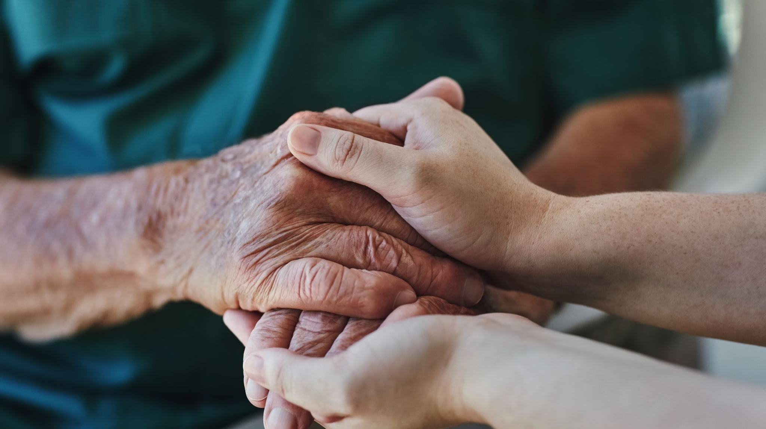
Visiting Angels The Villages: Giving Care to Veterans

Slide 2
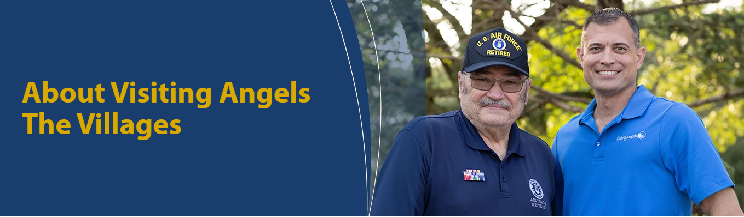
Visiting Angels is a national home care provider
Peg & Ron Pickett have owned The Villages location for over 14 years & have been rated #1 in this area for over 6 years in a row for in home non-medical care services.
Our mission is to help seniors live safely and comfortably at home.

Slide 3
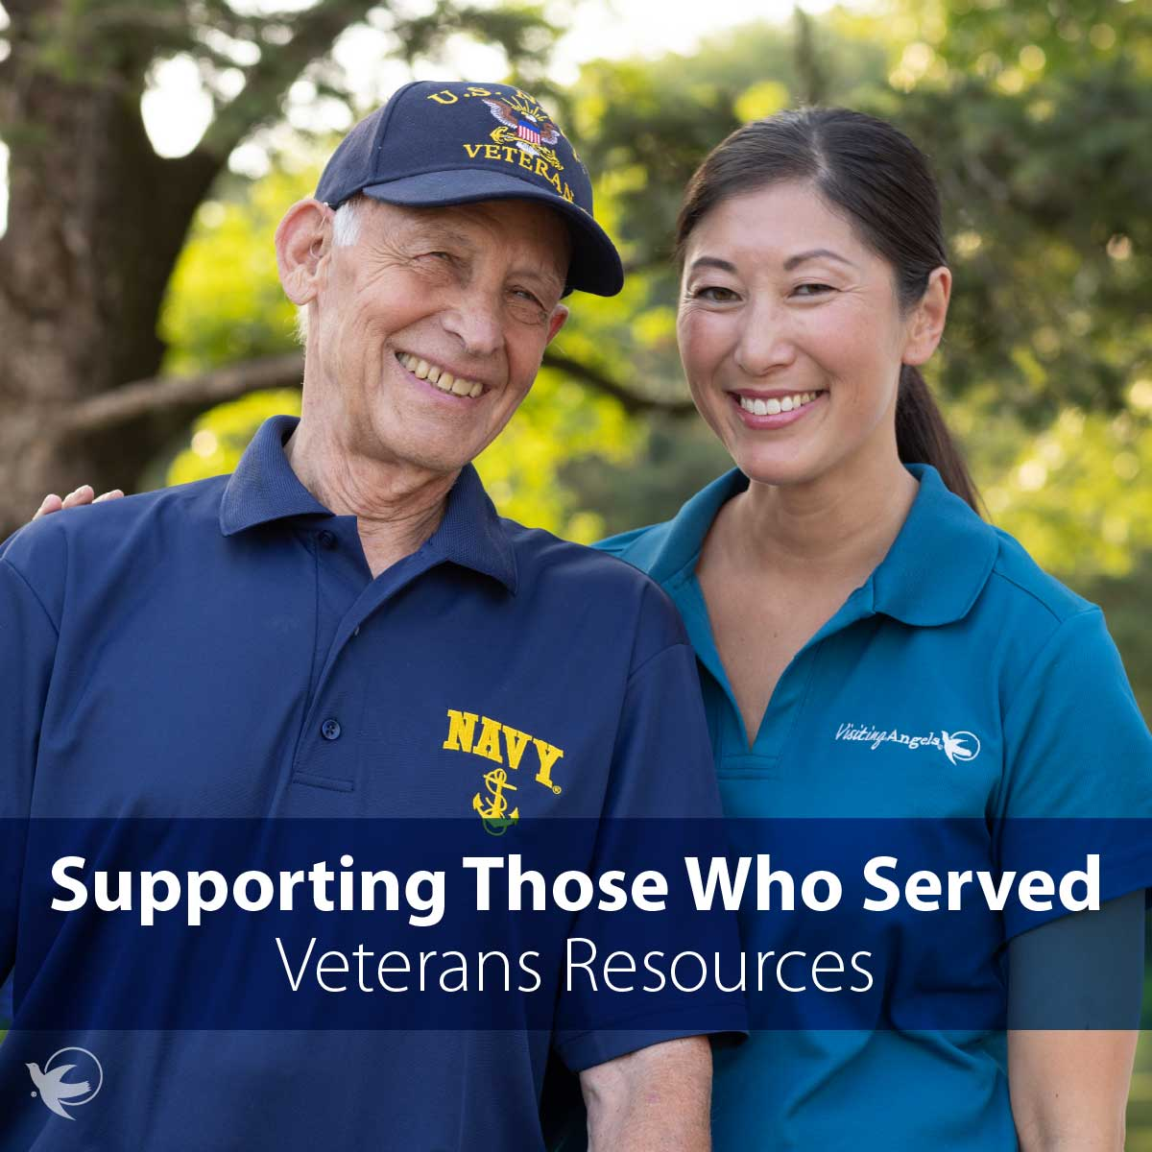
Commitment to Veterans
Dedicated to supporting U.S. military veterans and their families
Works with VA programs and benefits
Helps veterans maintain independence at home
Provides compassionate caregivers who understand veterans' needs

Slide 4

Visiting Angels Caregivers can assist Veterans with:
Personal care (bathing, dressing, grooming)
Meal preparation
Medication reminders
Light housekeeping
Transportation to appointments (in client’s vehicle)
Companionship

Slide 5

Specialized Support for Veterans
Our caregivers are trained to assist veterans in dealing with:
Mobility injuries
Chronic illness
Dementia or Alzheimer's
Parkinson's Disease
Care plans are customized for each veteran.

Slide 6

Why Choose Visiting Angels The Villages
Experienced and compassionate caregivers
Personalized care plans
Local offices with Veteran Administration support
Trusted by families across the country
Improves quality of life
Support for family caregivers

Slide 7
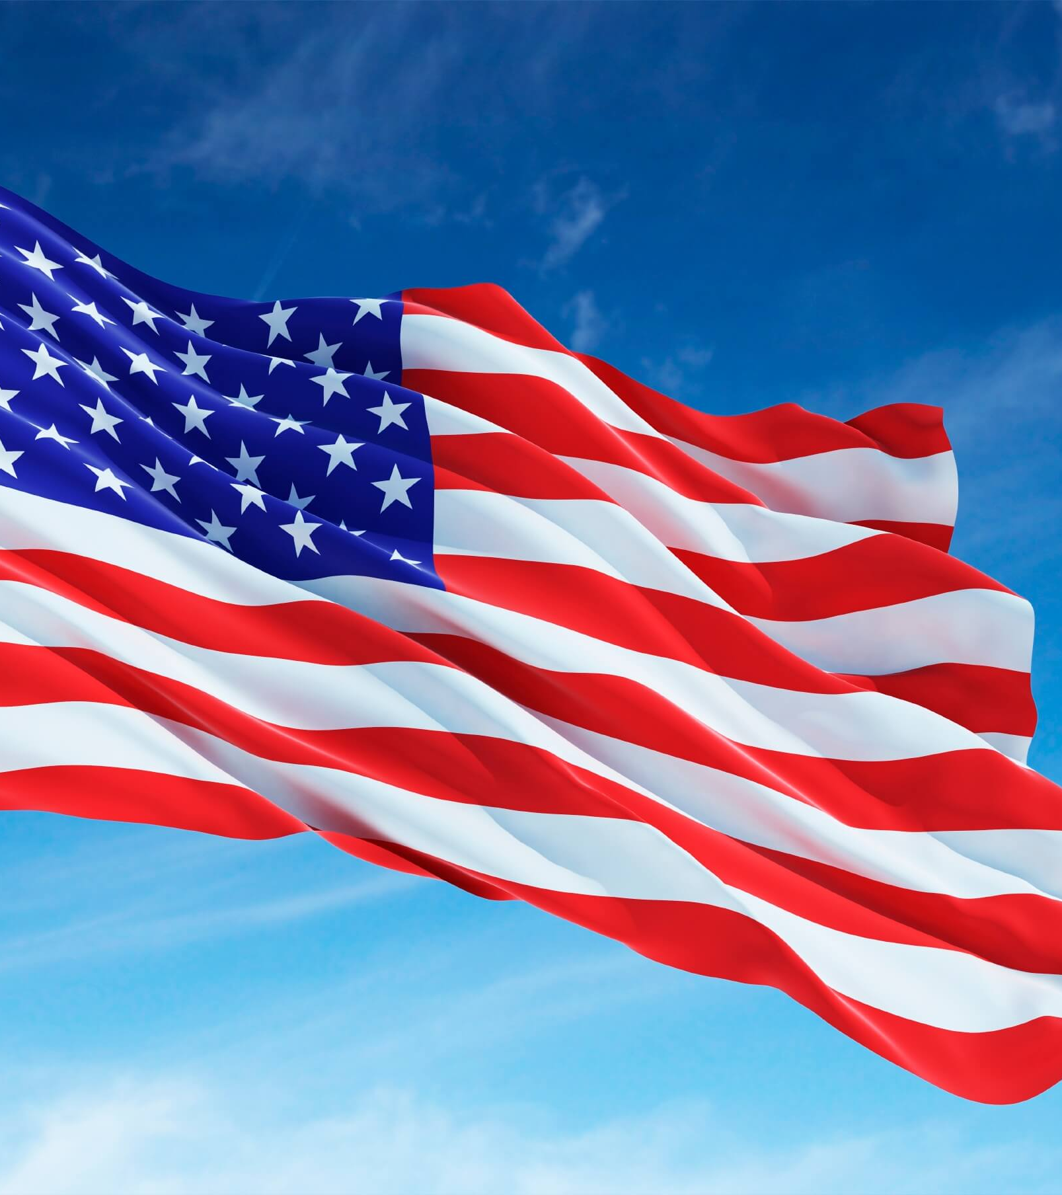
How to Get Started
Enroll with the VA, for VA Benefits at: www.1010ez.med.va.gov/sec/vha/1010ez and fill out form #1010-EZ
Mail or apply online, then call the VA at (888)-493-3260
The VA will schedule you for an assessment with a VA physician.
Request Home Health Aid (HHA) and/or Respite Visits from the VA physician. *Remember to designate Visiting Angels as your preferred provider.
The VA will assign care based on need. An authorization letter will be sent to each Veteran. Once received, we will schedule your Initial Assessment with our registered nurse.
Visiting Angels will directly bill the Veterans Administration for care.

Slide 8
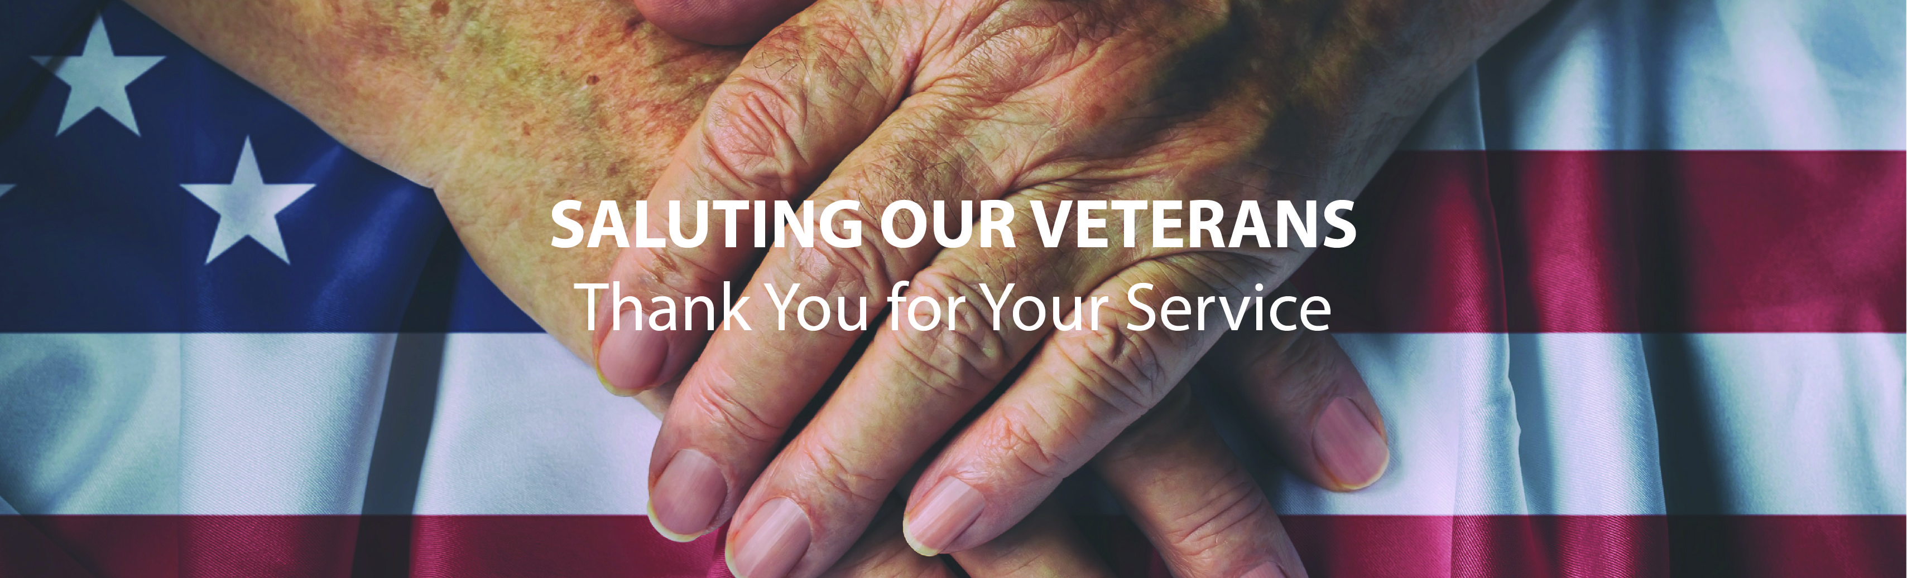
Thank you
Honoring Those Who Served
Questions?
Want to get started? Contact: Courtney Decker, Veteran Care Specialist
Visiting Angels The Villages
352-643-0702
https://www.visitingangels.com/servingthevillages/in-home-care-lady-lake?utm_source=gmb&utm_medium=organic&utm_campaign=local

